Slide 1

DOMAIN-COPILOT (D3T5) CASE STUDY
Multi-Agent Orchestration
in Practice
Rana Alaa Abdelaziz | Software Developer

Slide 2
DOMAIN-COPILOT (D3T5) CASE STUDY
How Our System is Built
hub
01 / GENERATION
verified_user
02 / HUMAN-IN-THE-LOOP
bug_report
03 / LESSONS LEARNED
Three Generation Agents
Producing competency reports, module outlines, and assessment items grounded in corpus evidence.
Durable Review Gate
State persistence using Postgres checkpointers with explicit approval & conditional routing.
Three Real Bugs
Hard-earned lessons on serialization, state transitions, and architectural boundaries in production.

Slide 3
Session Roadmap
01 / ORCHESTRATION ARCHITECTURE
Pipeline vs. agent framework, and what a graph buys you
05 / APPROVAL GATE
Pausing the graph with interrupt_before and persisting state via Postgres.
02 / GRAPH STRUCTURE
Nodes, edges, and the Clean Architecture boundary it has to respect
06 / LESSONS & BUGS
Three real bugs — serialization, illegal state transitions, and a stale ADR
03 / STATE & REDUCERS
The audit_trail bug that taught us why TypedDict fields need Annotated reducers
07 / REAL-TIME UX
Streaming progress and why cancellation is hard
04 / RESILIENCE PATTERNS
Timeout, retry-with-backoff, graceful degradation
08 / HANDS-ON LAB
You'll run this graph, break it, and fix it yourself

Slide 4
Pipeline vs Graph
format_list_numbered
Hand-Rolled Pipeline
hub
A Graph (LangGraph)
for step in [a, b, c]: step.run(state)
(state, config) → partial state
Retry, timeout, and pause/resume are each hand-built, per pipeline
Edges — including conditional edges — decide what runs next
Adding a human-approval pause means threading state through your own DB tables
A checkpointer persists state between nodes for free
Works fine — until step 4 needs to fail gracefully or pause for a day
interrupt_before turns "pause for human review" into one keyword arg

Slide 5
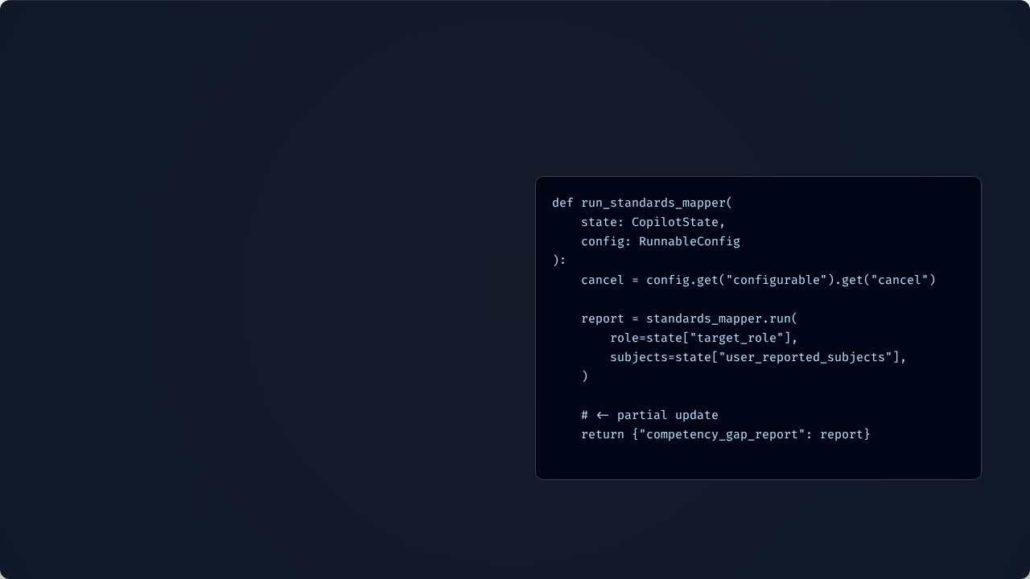
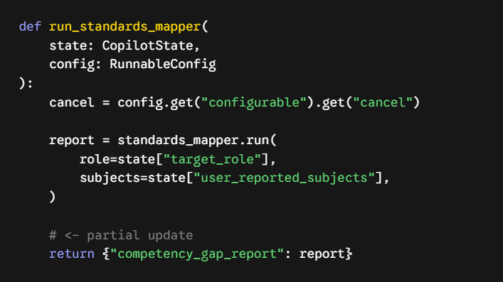
LangGraph Basics
01 / NODES & FUNCTIONS
A node is a plain function. It receives the full state, and a config carrying per-run values (thread_id, cancel_event) — it returns only the keys it's updating.
copilot_graph
02 / STATE REDUCTION
LangGraph merges that partial dict into state and hands the result to whatever node the edges point to next.
03 / GRAPH EDGES

Slide 6






System Workflow
End

Slide 7
Clean Architecture
← NEVER IMPORT: langgraph, fastapi, openai, sqlalchemy, psycopg2 →
domain/
Core Business Entities & Logic
application/
Use Cases & Port Interfaces
infrastructure/
LangGraph Lives Here
•
Infrastructure Isolation: copilot_graph.py file — containing all nodes, edges, and interrupt_before logic — is strictly confined to the infrastructure/orchestration/ folder.
•
Enforced Automatically: A custom CI test walks the AST of every file under domain/ and application/, instantly failing the build if it detects a restricted framework import .
•
Zero Framework Leakage: The three agents depend entirely on injected domain ports (like LlmProvider). They are completely decoupled and have no idea LangGraph exists.

Slide 8
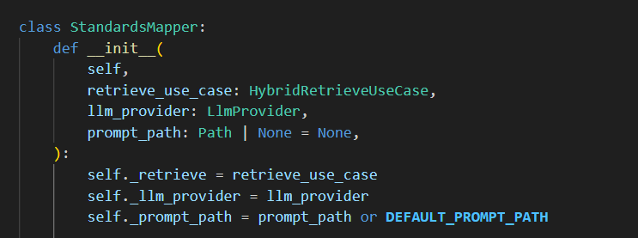
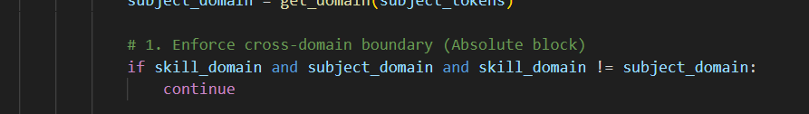
Agent 1: The Standards Mapper
DETERMINISTIC GUARDRAILS
ModuleOutlineGenerator
1. The LLM is just a parser
We only use the LLM to extract lists of required skills from the corpus. It does not make the final mapping decisions.
2.Absolute Domain Partitioning
strict Python token matching to guarantee zero cross-domain contamination
(e.g., an SQL skill can never match an API module)
ModuleOutlineGenerator
3.Zero FrameWork leakage
The agent operates purely on Domain Ports (LlmProvider, HybridRetrieveUseCase). It has no idea it is inside a LangGraph node

Slide 9
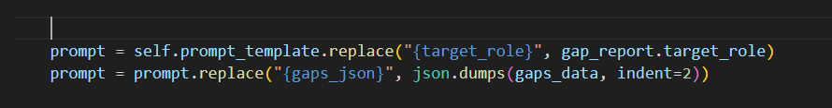
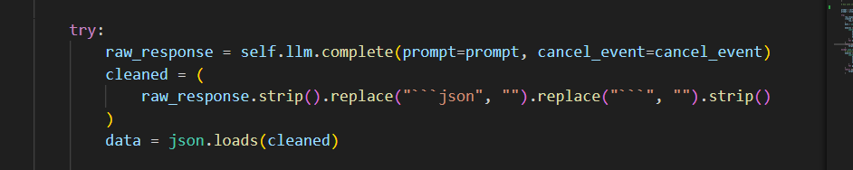
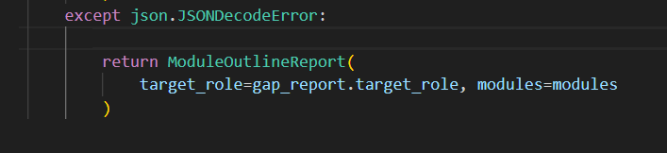
Agent 2: The Module Outline
DETERMINISTIC GUARDRAILS
ModuleOutlineGenerator
1. State Consumption
The agent knows nothing about the graph. It simply takes the CompetencyGapReport generated by Agent 1 and transforms it.
ModuleOutlineGenerator
2.Safe String Replacement
We use .replace() instead of .format() to prevent Python from crashing when injecting raw JSON arrays into the prompt template.
3. Graceful Degradation
If the LLM hallucinates markdown blocks or malformed JSON, we strip the syntax. If parsing still fails, we catch the JSONDecodeError and use a deterministic fallback mapping instead of crashing the workflow

Slide 10
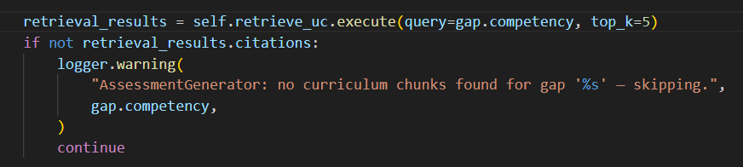
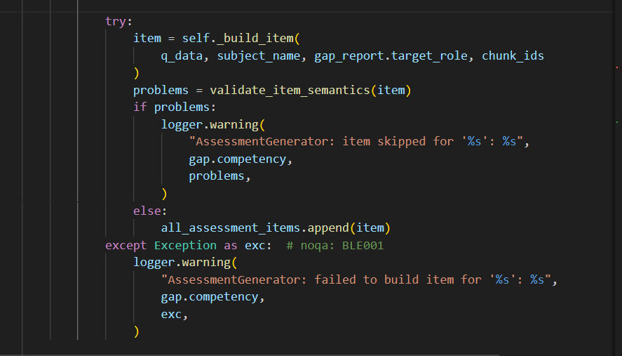
Agent 3: The Assessment Generator
DETERMINISTIC GUARDRAILS
AssessmentGenerator
1. Strict RAG Grounding
The agent retrieves context from the corpus first. If no source material is found for a gap, it completely skips it. It refuses to let the LLM hallucinate questions.
AssessmentGenerator
2. Batch Isolation:
We make one LLM call per subject and isolate them in try/except loops. A single malformed response will drop one question, rather than crashing the entire assessment array.
3. Semantic Validation
Every generated question passes through a deterministic validator (checking option counts, letter mappings) before being appended to the state.

Slide 11
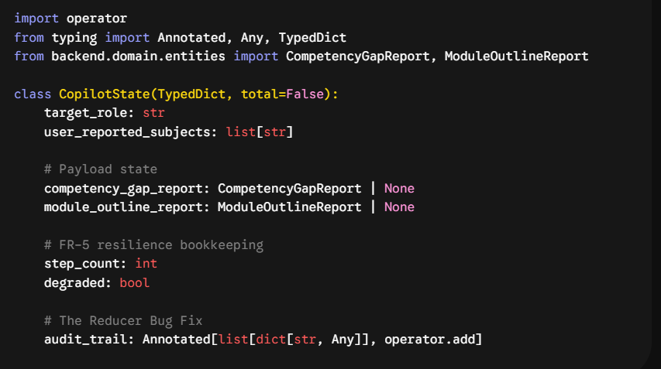
The Orchestrator (State & Reducers)
STATE ARCHITECTURE
1. TypedDict State
The graph passes a strongly-typed CopilotState dictionary between nodes. Each agent only reads what it needs and returns partial updates.
copilot_graph.py
2. The Overwrite Bug
Originally, audit_trail was a standard list. When multiple nodes returned audit logs, LangGraph silently overwrite the previous node's data instead of keeping a running history.
3. Annotated Reducers
We fixed this using Annotated[list, operator.add]. This tells LangGraph's internal state manager to reduce (merge) updates by appending them, creating a continuous historical log.

Slide 12



Resilience Wrapper
Every agent call is wrapped, not called directly.
ThreadPoolExecutor, 60s
max 2 retries, backoff
•
On timeout → ; on node exception → up to 2 retries with exponential backoff.
•
Explicit Cancellation: Unlike timeouts, if a ClientCancelledError is caught, the system immediately halts. It respects the user's cancellation and never retries.
•
If every retry fails, the node degrades gracefully: it falls back to plain retrieved evidence rather than crashing the whole graph, and records .

Slide 13
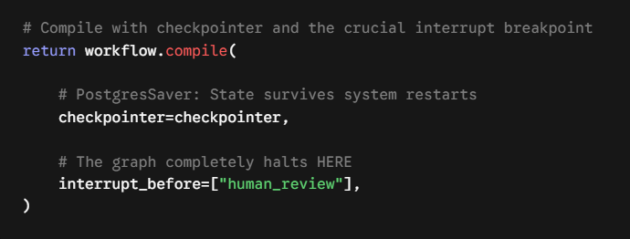
The Approval Gate
Durable Pausing
The graph genuinely halts before the human_review node, writing a durable checkpoint row to Postgres and returning control to the application layer.
human_review
State Retrieval
The frontend calls get_state(config) to fetch the paused payload, allowing the instructor to safely inspect the generated outline and assessment.
Resuming the Graph
Once approved, we call update_state() to inject the human's feedback and resume graph execution from that exact checkpoint.

Slide 14
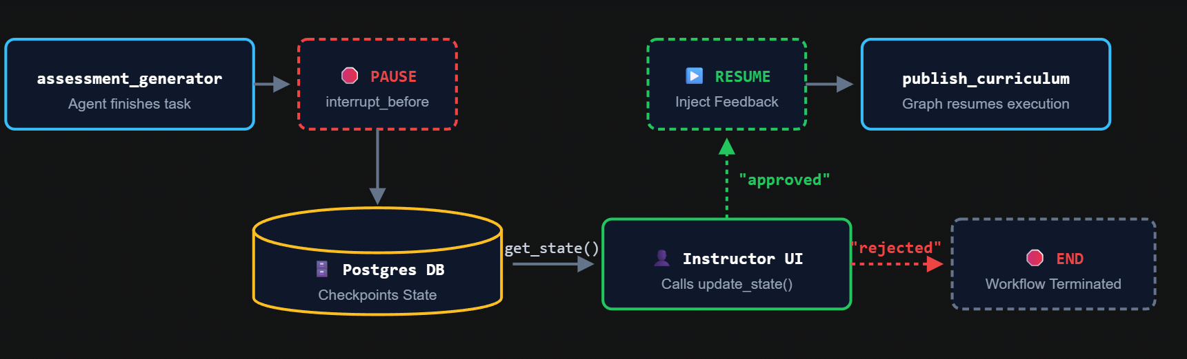
The Human-in-the-Loop Lifecycle

Slide 15
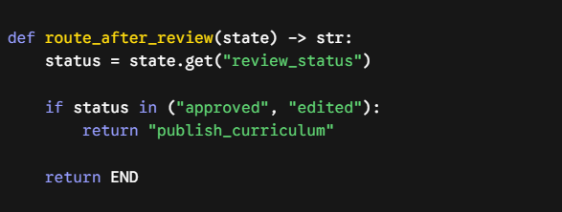



Conditional Routing
A router is just a function of state returning a node name — wires the map.

Slide 16
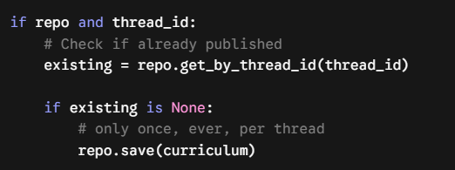
Idempotent Publish
has to assume it might run twice in a checkpointed execution graph.
Idempotency Guarantee
Checkpointed graphs can be re-invoked via retries, replays, or resumed threads.
Side-Effect Protection
Any node with an external side effect must guard against executing twice.
Architecture Rule
System design explicitly enforces that no side-effecting call may run before review status is approved—no trusted bypass path exists.

Slide 17
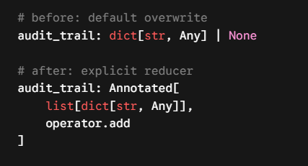
Bug #1: audit_trail
•
Every reviewer action returns .
•
With a plain field, each node's return value overwrites state — a second review decision would erase the first.
•
tells LangGraph how to merge: concatenates lists instead of replacing them.
•
Lesson: Any state field a node can update more than once needs an explicit reducer.

Slide 18
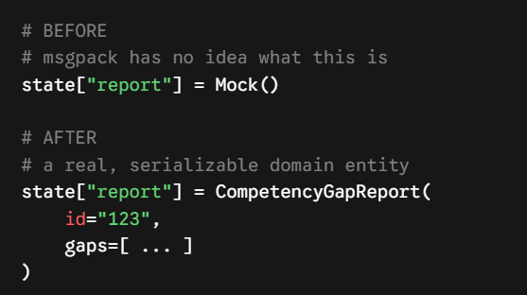
Bug #2: TypeError
TypeError: Type is not msgpack serializable: Mock
•
A routing test injected objects into state fields meant to hold Domain Reports.
•
LangGraph's checkpointer serializes state to persist it — and Mock instances aren't serializable.
•
Lesson: If it goes into checkpointed state, it has to be a real, serializable domain object — a stand-in isn't enough.

Slide 19



Bug #3: State Flow
Test attempted to skip intermediate states
•
State Machine Invariant: ReviewTaskRepository ensures a task cannot jump straight from pending to approved
•
Test Bypass: A test attempted to transition directly by hacking the property instead of using the controlled assign() method.
•
Action Mapping: Fixed the test, not the guardrail. The review action map permits only valid transitions: approve -> approved or reject -> rejected

Slide 20
Live Demo
bash - demo.sh
01
Step 1 (The Trigger)
Initialize the script to spin up the agents (standards_mapper -> module_outline_generator -> assessment_generator).
$ python -m backend.scripts.run_hitl_demo
🚀 Initializing Domain Copilot HITL Workflow Demo...
... standards_mapper -> module_outline_generator -> assessment_generator ...
⏸ Paused before human_review. thread_id = demo-thread-001
# in a second terminal / psql, or via get_state():
>>> review_service.get_pending_review("demo-thread-001")
{'status': 'pending_review', 'competency_gap_report': {...}, ...}
>>> review_service.process_review_decision("demo-thread-001", action="approve")
▶ Resuming thread demo-thread-001 from human_review...
02
Step 2 (The Pause)
Watch the graph automatically halt at interrupt_before human review, persisting state safely to PostgreSQL.
03
Step 3 (The Resume)
Fetch the pending review via the service, approve the decision, and watch the graph resume execution seamlessly.

Slide 21
Next Up: The Hands-On Lab
Coming Up: What you'll do in the lab
•
Spin up & Verify: Run the local environment, Postgres, and architecture tests.
•
Execute & Inspect: Run the HITL workflow, pause at the review gate, and approve via the API.
•
Break & Fix: Reproduce the state bugs (reducers and serialization) and implement the fixes.
•
Stretch Challenges: Tackle advanced tasks including writing the ADR documentation.

Slide 22

Recap & Q&A
•
A graph buys you pause/resume, retry, and conditional routing for free — but only if state is designed carefully.
•
Every field a node can update more than once needs an explicit reducer.
•
Anything that reaches checkpointed state must be a real, serializable domain object.
•
Side-effecting nodes must assume they can be re-invoked.
•
"Stopped streaming" and "stopped computing" are two different things.
Questions? → docs/adr/, docs/AI-USAGE-LOG.md, and backend/tests/ are the real source of truth.

Slide 23
Thank You!
Rana Alaa Abdelaziz | Software Developer

